Slide 1

Text-Based motion detection
Datasets & current advances

Slide 2

Publicly available datasets for detecting emotions in texts

Slide 3
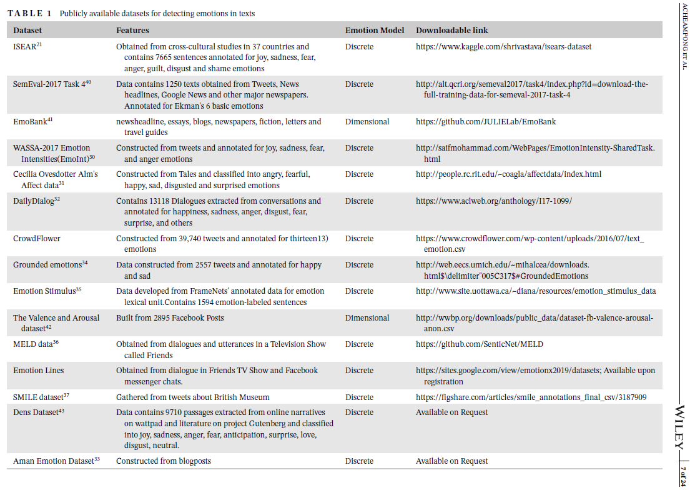

Slide 4

Summary of current advances in text-based emotion detection

Slide 5
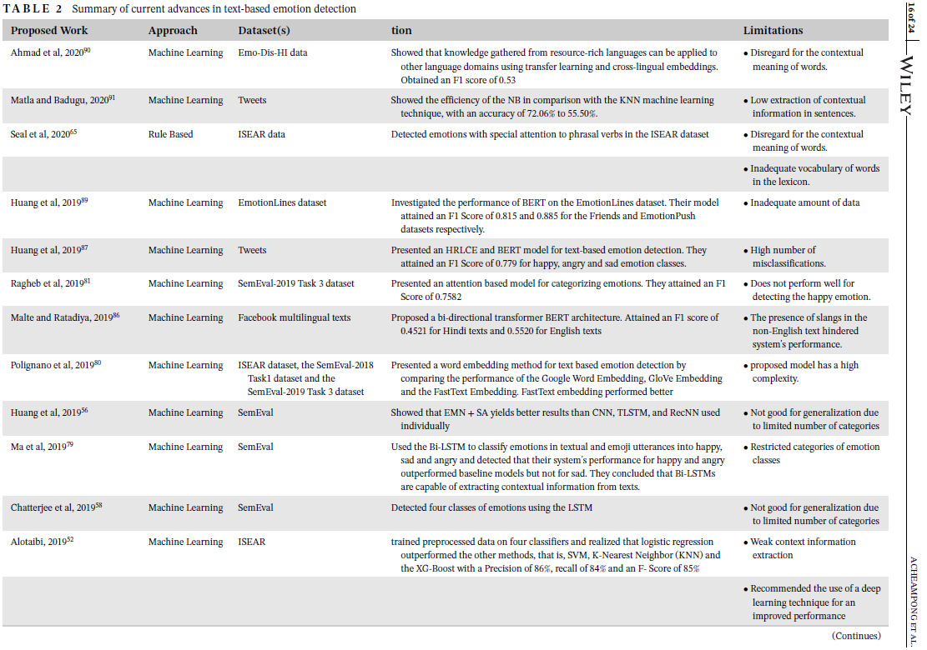

Slide 6
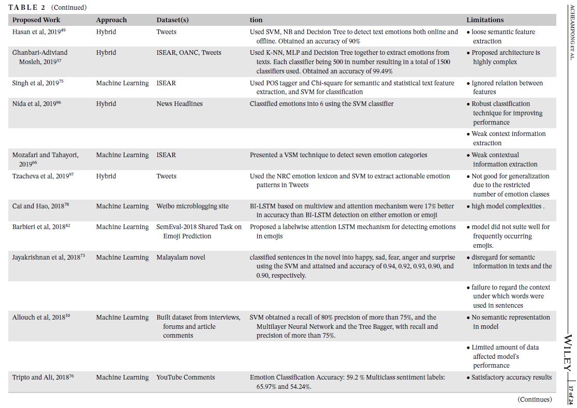

Slide 7
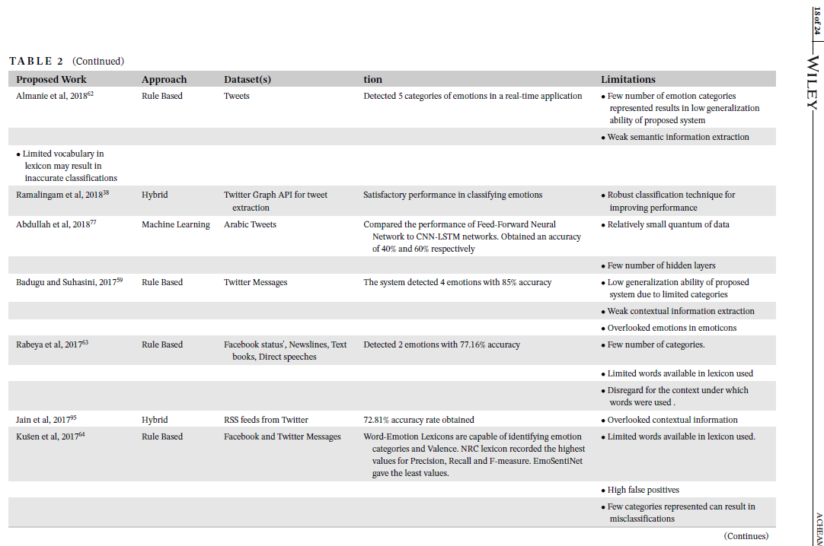

Slide 8
